Slide 1
Weekly Update #15
Gijs Admiraal

Slide 2
Recap from previous weeks
Started exploring topics: atom-by-atom generation, non-standard amino acids (nsAA), (chemical) language models, data augmentation, discrete diffusion
Finished 10-week deadline
Compare different protein sequence representations (amino acids, all-atom, etc.) in a discrete diffusion setting with a D3PM
Started setting up in the cluster
A lot of troubles with original D3PM implementation
Tried different implementation and settled on D3PM minimal

Slide 3

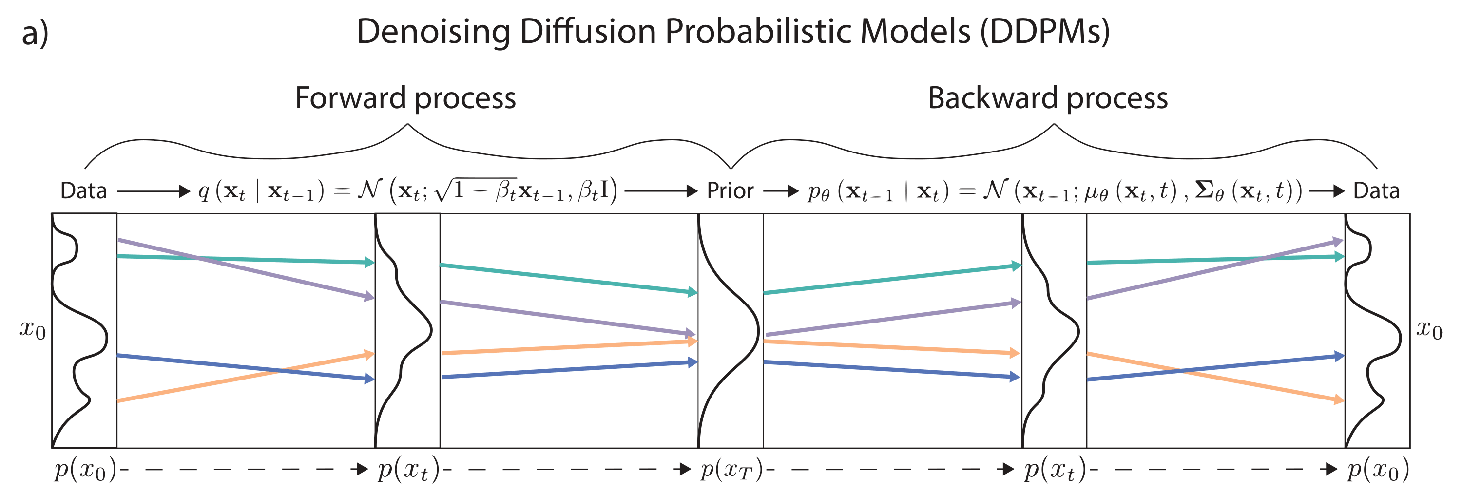
General diffusion model
Forward process corrupts data:
Backwards process removes corruption:

Slide 4
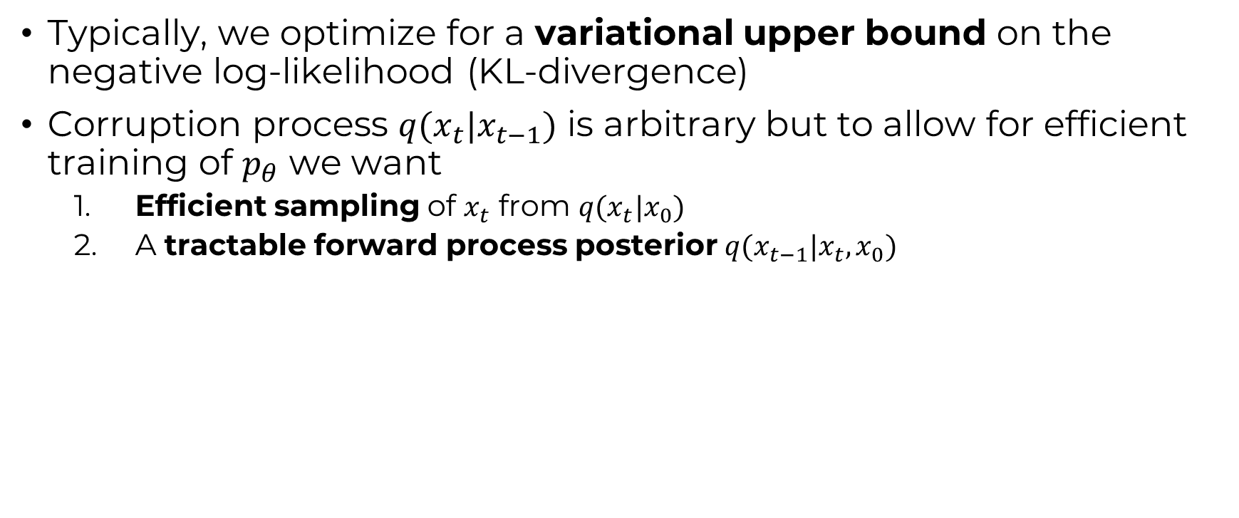
General diffusion model
Typically, we optimize for a variational upper bound on the negative log-likelihood (KL-divergence)
Corruption process $q(x_{t}|x_{t−1})$ is arbitrary but to allow for efficient training of $p_{θ}$ we want
Efficient sampling of $x_{t}$ from $q(x_{t}|x_{0})$
A tractable forward process posterior $q(x_{t−1}|x_{t}, x_{0})$

Slide 5
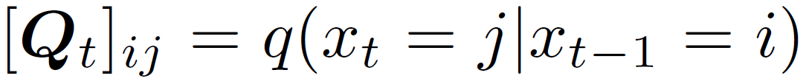
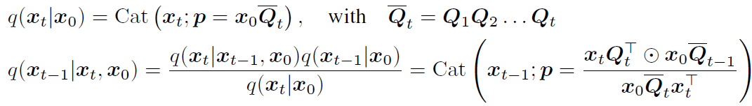
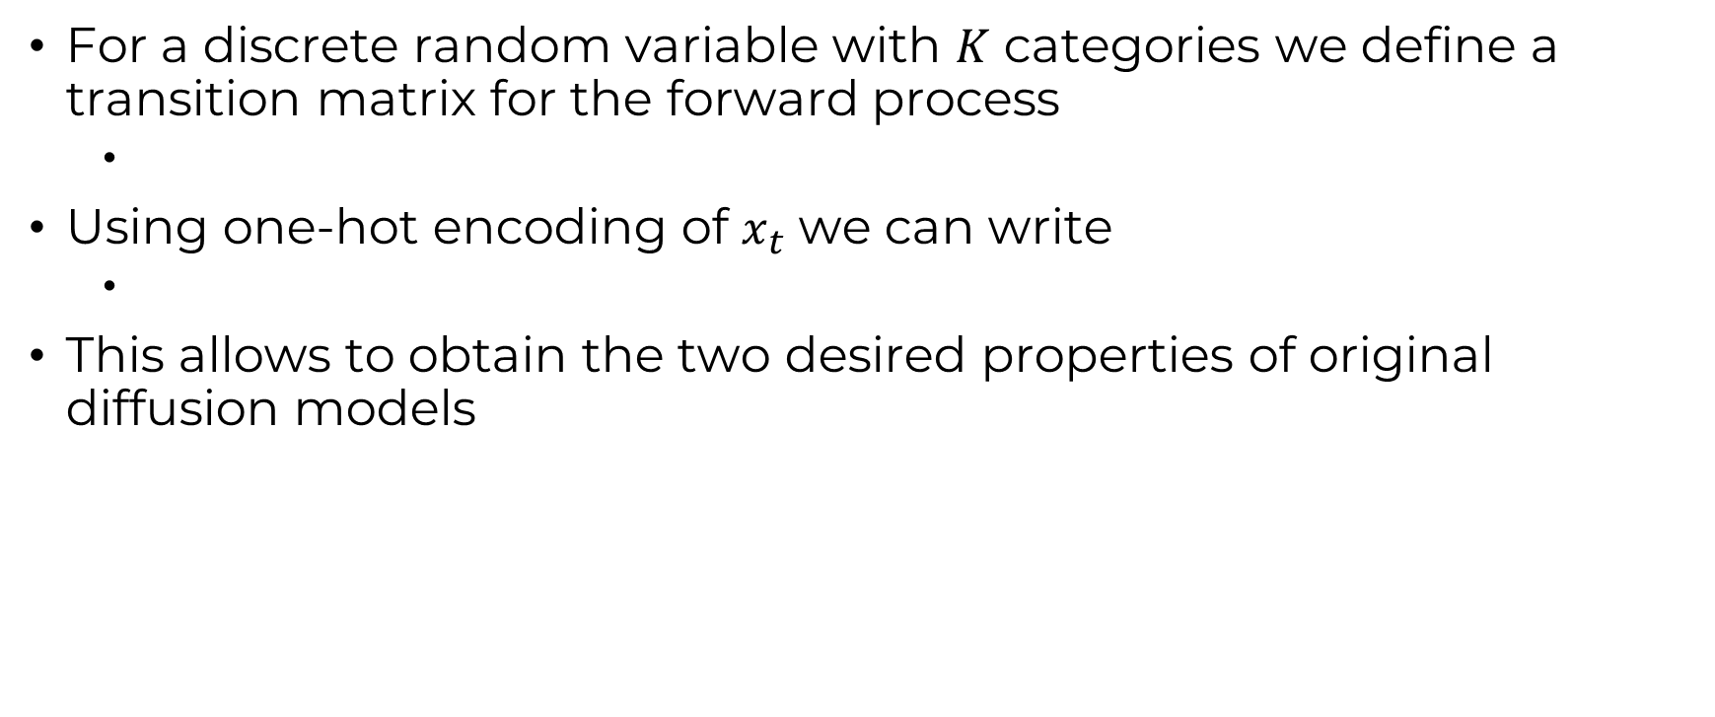
Discrete DDPM (D3PM)
For a discrete random variable with $K$ categories we define a transition matrix for the forward process
Using one-hot encoding of $x_{t}$ we can write
This allows to obtain the two desired properties of original diffusion models

Slide 6

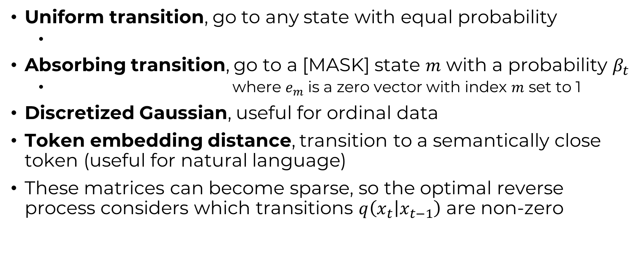
Transition matrices
Uniform transition, go to any state with equal probability
Absorbing transition, go to a [MASK] state $m$ with a probability $β_{t}$
where $e_{m}$ is a zero vector with index $m$ set to 1
Discretized Gaussian, useful for ordinal data
Token embedding distance, transition to a semantically close token (useful for natural language)
These matrices can become sparse, so the optimal reverse process considers which transitions $q\left(x_{t} | x_{t−1}\right)$ are non-zero

Slide 7
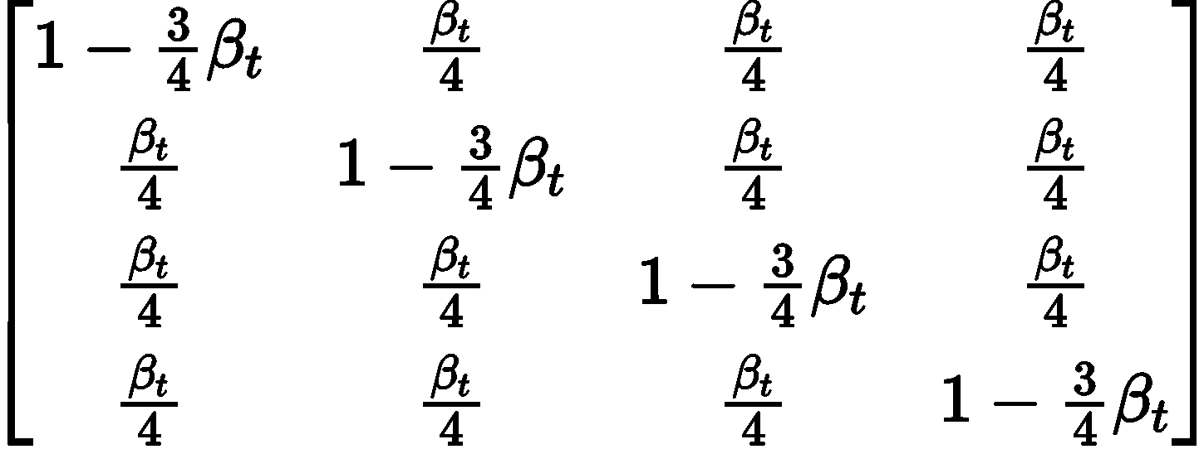
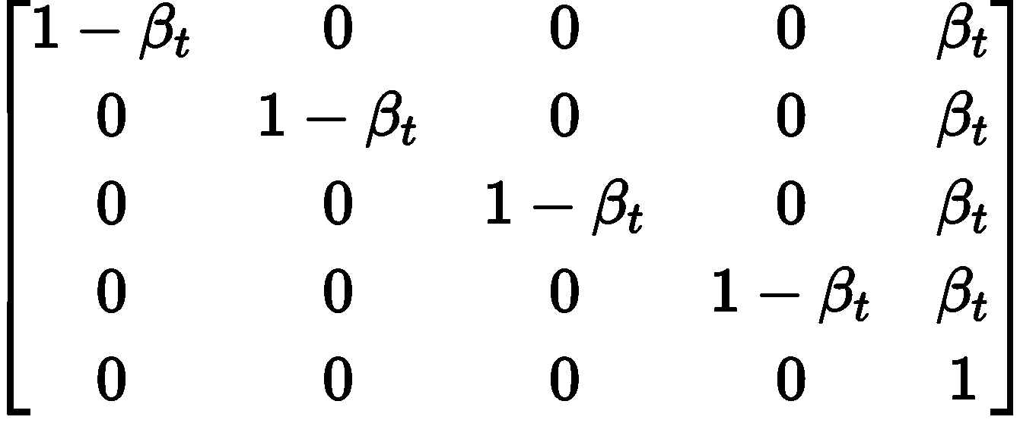
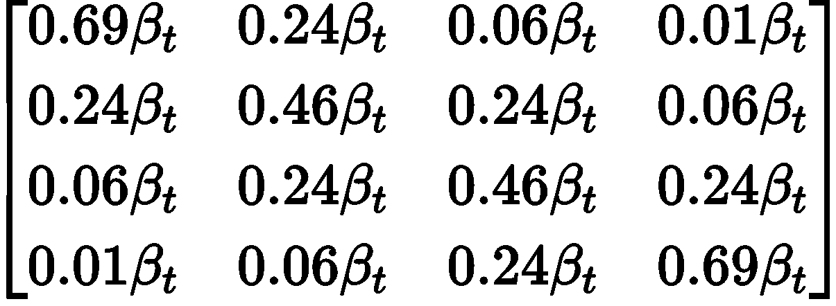
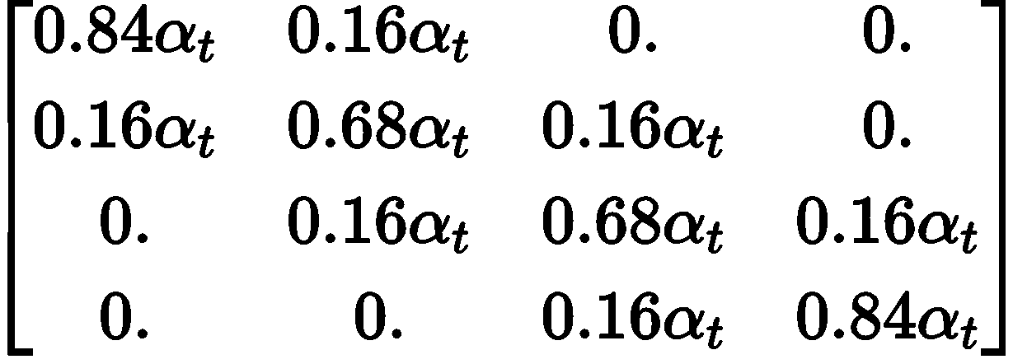
Transition Matrix example
Uniform
Absorbing state
Discrete Gaussian
Token embedding
In reality we want a matrix that maintains a uniform stationary distribution

Slide 8
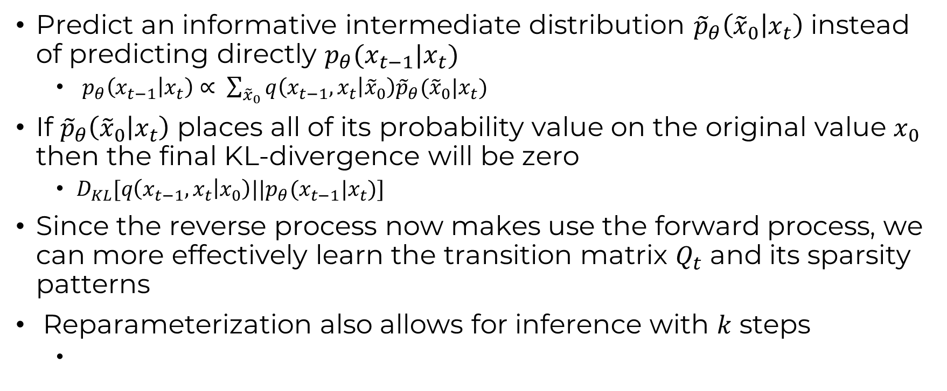
D3PM – reparameterization of reverse process
Predict an informative intermediate distribution ${\tilde{p}}_{θ}\left({\tilde{x}}_{0} | x_{t}\right)$ instead of predicting directly $p_{θ}(x_{t−1}|x_{t})$
$p_{θ}\left(x_{t−1} | x_{t}\right)∝ \sum_{{\tilde{x}}_{0}}{q\left(x_{t−1},x_{t} | {\tilde{x}}_{0}\right){\tilde{p}}_{θ}({\tilde{x}}_{0}|x_{t}) }$
If ${\tilde{p}}_{θ}\left({\tilde{x}}_{0} | x_{t}\right)$ places all of its probability value on the original value $x_{0}$ then the final KL-divergence will be zero
$D_{KL}[q\left(x_{t−1},x_{t} | x_{0}\right){||p}_{θ}(x_{t−1}|x_{t})]$
Since the reverse process now makes use the forward process, we can more effectively learn the transition matrix $Q_{t}$ and its sparsity patterns
Reparameterization also allows for inference with $k$ steps

Slide 9
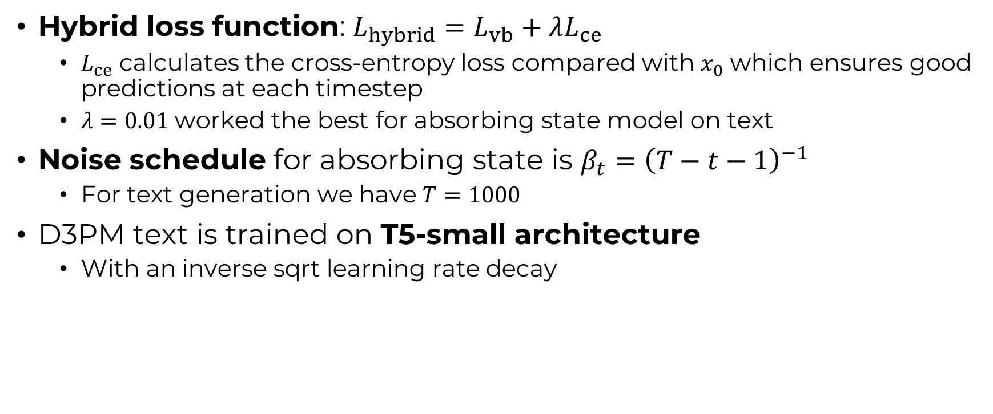
D3PM
Hybrid loss function: $L_{hybrid}=L_{vb}+λL_{ce}$
$L_{ce}$ calculates the cross-entropy loss compared with $x_{0}$ which ensures good predictions at each timestep
$λ=0.01$worked the best for absorbing state model on text
Noise schedule for absorbing state is $β_{t}={\left(T−t−1\right)}^{−1}$
For text generation we have $T=1000$
D3PM text is trained on T5-small architecture
With an inverse sqrt learning rate decay

Slide 10

D3PM similarities
D3PM with a mix of uniform and absorbing transitions is similar to BERT objective when $T=1$
Also similar to (Generative) Masked Language-Models (MLMs)
MLMs are trained on predicting $k$masked tokens given context according to some schedule

Slide 11
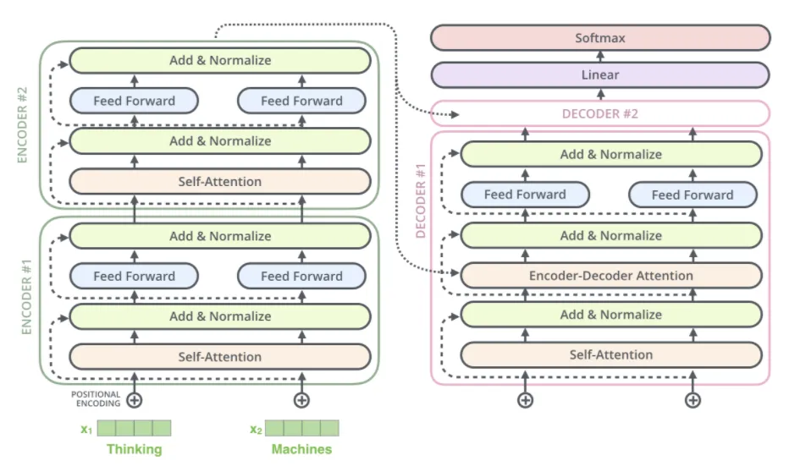
T5 architecture
Uses relative positional encodings instead of absolute positional encodings
Effective when working with longer sequences
Applies normalization before sub-layer and residual connection
Ensures better gradient flow and training stability
Normalization is scale only (does not shift)
Is more efficient and simpler

Slide 12
Code base
Only has uniform transition
Add absorbing state transition
Does not use reparameterization
Only for efficiency so perhaps later
During training 3 metrics are observed
Train loss, measures how well the model performs
Train grad norm, shows how big the updates are to model parameters
Train param norm, shows the magnitude of model parameters

Slide 13
UniRef50

Slide 14

Data analysis – Amino Acid Sequence
Directly from FASTA
Vocabulary size of 20
Average length of 68
Example:

Slide 15

Data analysis – All-Atom Sequence
Use RDKit and SELFIES packages
Vocabulary size of 21
[#Branch1], [Branch1], [#C], [=O], [O], [C@@H1], [Branch3], [=C], [=Branch2], [C], [#Branch2],
[=Branch1], [C@H1], [NH1], [P], [N], [Ring2], [S], [=N], [Branch2], [Ring1]
Average length of 913
Example:
[C][C][C@H1][Branch1][C][C][C@H1][Branch3][#Branch2][P][#Branch2][N][C][=Branch1][C][=O][C@H1][Branch1][C][C][N][C][=Branch1][C][=O][C@H1][Branch1][#Branch2][C][C][=C][C][=C][C][=C][Ring1][=Branch1][N][C][=Branch1][C][=O][C@H1][Branch1][Ring1][C][S][N][C][=Branch1][C][=O][C@H1][Branch1][#Branch1][C][C][=Branch1][C][=O][O][N][C][=Branch1][C][=O][C@@H1][Branch3][#Branch2][=N][=Branch2][N][C][=Branch1][C][=O][C@H1][Branch1][Branch2][C][C][C][Branch1][C][N][=O][N][C][=Branch1][C][=O][C@H1][Branch1][=Branch2][C][C][=C][NH1][C][=N][Ring1][Branch1][N][C][=Branch1][C][=O][C@H1][Branch1][#Branch1][C][C][Branch1][C][C][C][N][C][=Branch1][C][=O][C@@H1][Branch3][#Branch2][=Branch2][N][N][C][=Branch1][C][=O][C@H1][Branch1][=Branch1][C][C][C][C][N][N][C][=Branch1][C][=O][C@H1][Branch1][=Branch2][C][C][=C][NH1][C][=N][Ring1][Branch1][N][C][=Branch1][C][=O][C@H1][Branch1][Branch2][C][C][C][Branch1][C][N][=O][N][C][=Branch1][C][=O][C@H1][Branch1][Branch2][C][C][C][Branch1][C][N][=O][N][C][=Branch1][C][=O][C@H1][Branch1][#Branch2][C]

Slide 16

Data analysis – Functional Group Sequence
Using RDKit package
Vocabulary size of 15
CNC(C)=O, CC(=O)N(C)C, CNC, CN, CC(=O)O, cnc, CN(C)C(C)=O, CO, cO, CS, CC(N)=O, CNC(=N)N, CC(=O)NC, CSC, c[nH]c
Average length of 109
Example
CNCNC(C)=OCSCCNC(C)=OCNCNC(C)=OCOCNC(C)=OCNC(C)=OCNC(C)=OCNC(C)=OCNC(C)=OCOCNC(C)=OcOCNC(C)=OCNC(C)=OCNC(C)=OCSCNC(C)=OCNC(C)=OCNC(C)=OCNC(C)=OCNC(C)=OCC(=O)OCNC(C)=OcOCNC(C)=OCNCNC(C)=OCC(=O)OCNC(C)=OCC(=O)OCNC(C)=OCC(=O)OCNC(C)=OCC(=O)OCNC(C)=OCNCNC(C)=OCNC(C)=OCNC(C)=OCC(=O)NCCNC(C)=OcOCNC(C)=OCOCNC(C)=OCSCNC(C)=OCNC(C)=OCC(=O)OCNC(C)=OCC(N)=OCNC(C)=OCOCNC(C)=OCNC(C)=OCC(=O)OCNC(C)=OCOCNC(C)=OCNC(C)=OCC(N)=OCNC(C)=OCNC(C)=OCOCC(=O)NCCNC(C)=OCC(N)=OCNC(C)=OCNC(C)=OCOCNC(C)=OCNC(C)=OcOCNC(C)=OCC(N)=OCNC(C)=OCNC(=N)NCNC(C)=OCNC(C)=OCNCNC(C)=Ocncc[nH]cCNC(C)=OCNCC(=O)N(C)CCNC(C)=OCNC(C)=OCOCNC(C)=OCOCNC(C)=OCNC(C)=OcOCNC(C)=OCC(=O)OCNC(C)=OCC(=O)OCNC(C)=OcOCC(=O)NCCNC(C)=OCNCNC(C)=OCC(N)=OCNC(C)=OCOCNC(C)=OCOCNC(C)=OCNC(C)=OCC

Slide 17
Functional groups – Some questions
How do we get back to atom sequence or mol object
Are these the correct functional groups for proteins?
group.atoms = O=CO, S, N=C(N)N, N, NC=O, O, [nH]
group.type = CNC(C)=O, CC(=O)N(C)C, CNC, CN, CC(=O)O, cnc, ...

Slide 18
Notes
Add how Q matrices look

